Slide 1
Intro to Coding & Website Basics
MSP Ryan Wedoff
University of Iowa

Slide 2
Who is this guy?
Microsoft Student Partner
Host monthly workshop on tech
Loves tech, Microsoft Products and building stuff
First year Master in Computer Science
BS in CS May 2017
ACM President (“Iowa’s Computer Science club”)
Microsoft Intern
Fargo ND Summer 2016
Seattle WA Summer 2017
Notes:
Introduce name!
Who here has coding experience?
Who here has used excel formulas?
What majors is everyone?
What computers do you use?

Slide 3
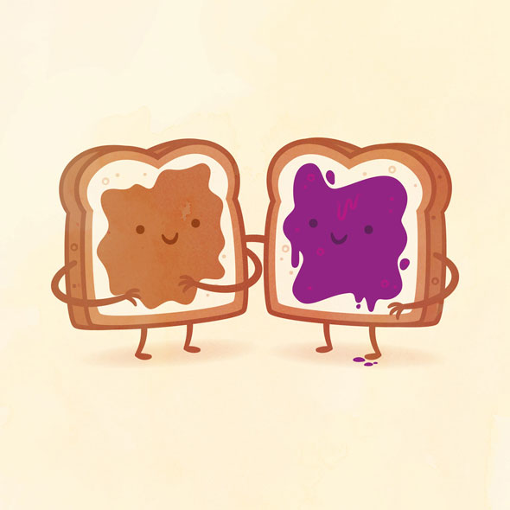
Peanut Butter and Jelly Activity
Group activity:
I don’t know how to make a PBJ sandwich. I need help!
Notes:
What do this have to do with computer and coding?
Coding is the art of writing a program for the a computer. The computer will do exactly what you tell it to do. Just like the PBJ activity, it will literally do what you tell it to do, even if that is wrong!

Slide 4


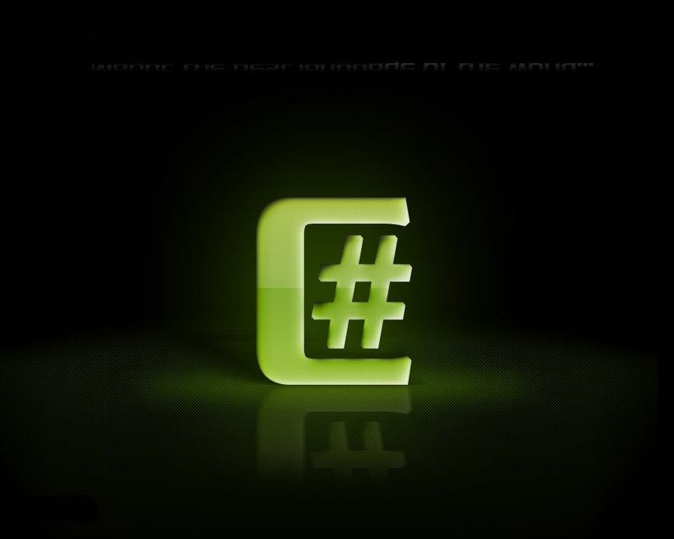

How do I code?
Computer reads 110110110110100100100100100100101001001
You don’t need to know binary!
Coding languages eventually (assembly) boil down to 11101101101001001
Programming languages are written in words that are easy to understand
Common programming languages:
Notes:
What do this have to do with computer and coding?
Coding is the art of writing a program for the a computer. The computer will do exactly what you tell it to do. Just like the PBJ activity, it will literally do what you tell it to do, even if that is wrong!

